Slide 1
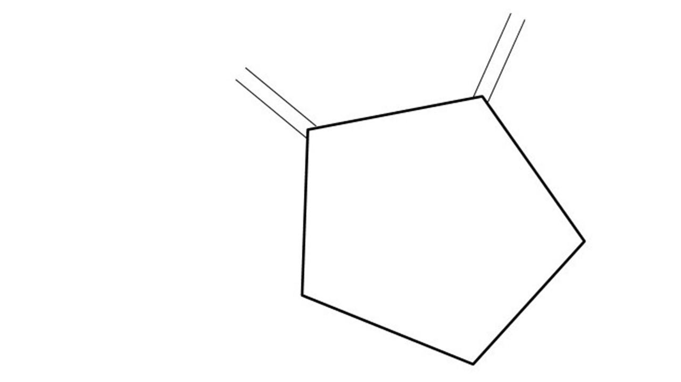
Great Cow BASIC Part 2
Great Cow BASIC for the PIC16F171xx chip Family
Oct 2021

Slide 2
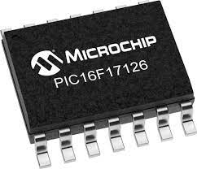
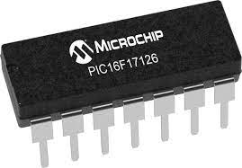
PIC16F171xx
PIC16F171xx is a high performance PIC16
Digital and Analog peripherals
12-bit ADC
Multiple communication interfaces
Serial, I2C, SPI
PWM – CCP/PWM and 16Bit
Configurable Logic Cells
OpAmp
The PIC16F171xx offers 8 to 20 pin products in small footprint packages to support customers in a variety of space constrained and sensor node applications.

Slide 3
Videos...
Install the hardware and make the board work – three LED programs
Make four LEDs flash in a sequence
Set the LEDs to represent the value of ADC
Sequence the LEDs with a delay using the value of ADC
Using an input to set the state of the LEDs
Using the reset switch
Using the switch, ADC – may the LEDs flash in a sequence with reverse
Using the serial to display values
Using the timer0 overflow, 8bit timer, 16bit timer to flash the LEDs
Using CCP/PWM to dim the LEDS
Using I2C with serial to discover I2C devices
Using EEProm – showing values on the serial terminal
Using an I2C GCLD display
Using an SPI GCLD display
Using PWM to dim the LEDS
Using memory within the PIC – Progmem and SAF memory
The Great Cow BASIC tool chain
Assembly and alternatives assemblers
Summary

Slide 4
Great Cow BASIC Compiler
Great Cow BASIC is an Open Source compiler for Microchip PIC, AVR and LGT microcontrollers
Great Cow BASIC now supports the 16F171xx chip family
Great Cow BASIC Compiler

Slide 5

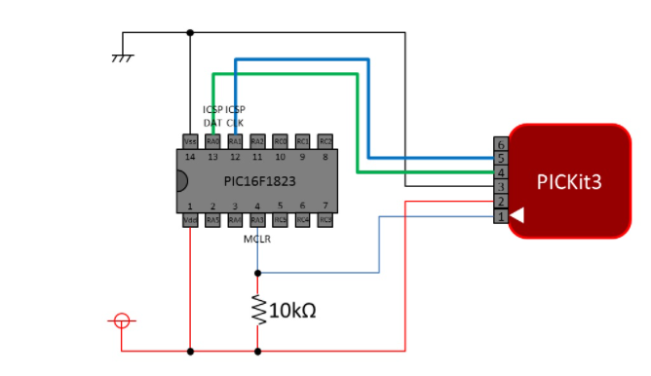
Microcontroller connectivity
PIC16F17126

Slide 6
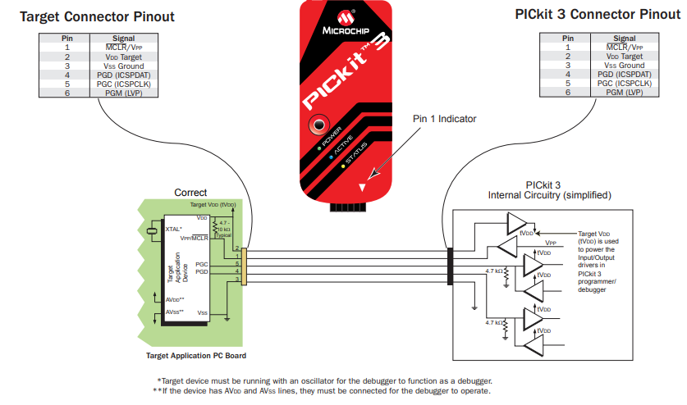

Slide 7
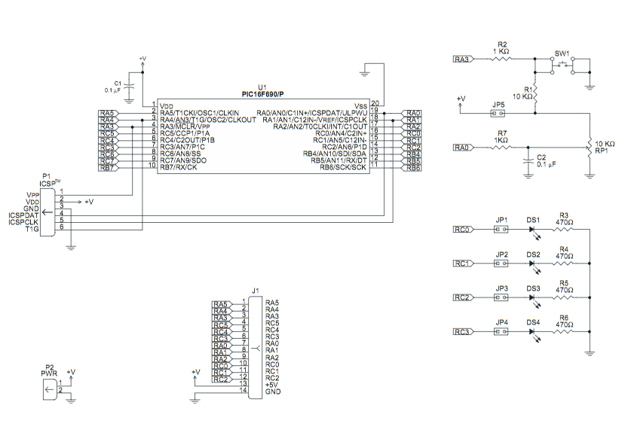
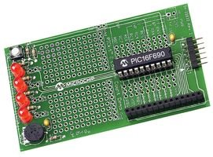

Hardware
Microchip Low Pin Count Demo Board
PICKit_2_Low_Pin_Count_User_Guide_51556a.pdf

Slide 8
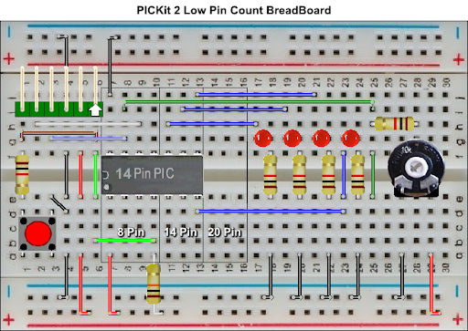
Hardware
Layout
By Chris Roper

Slide 9
Basic setup - recap
Downloaded and installed GCStudio using the default values
Attached microcontroller to the programmer via a suitable board
Validated programming communications

Slide 10
Lab Cam

Slide 11
Make four LEDs flash in a sequence
Initialise
Set 1st LED
Delay
Rotate the LEDs
Did it overflow ?
No
Yes
Set 1st LED

Slide 12
Rotate with Carry
 | LED4 = C.3 | LED3 = C.2 | LED2 = C.1 | LED1 = C.0 | CARRY = SREG.0
Start | 1 | 0 | 0 | 0 | 0
Rotate(shift) | 0 | 1 | 0 | 0 | 0
Rotate(shift) | 0 | 0 | 1 | 0 | 0
Rotate(shift) | 0 | 0 | 0 | 1 | 0
Rotate(shift) | 0 | 0 | 0 | 0 | 1
Restart | 1 | 0 | 0 | 0 | 0
Rotate(shift) | 0 | 1 | 0 | 0 | 0

Slide 13
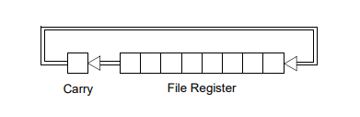
Rotate with Carry
 | LED4 = C.3 | LED3 = C.2 | LED2 = C.1 | LED1 = C.0 | CARRY = SREG.0
Start | 1 | 0 | 0 | 0 | 0
Rotate(shift) | 0 | 1 | 0 | 0 | 0
Rotate(shift) | 0 | 0 | 1 | 0 | 0
Rotate(shift) | 0 | 0 | 0 | 1 | 0
Rotate(shift) | 0 | 0 | 0 | 0 | 1
Restart | 1 | 0 | 0 | 0 | 0
Rotate(shift) | 0 | 1 | 0 | 0 | 0

Slide 14
Rotate with Carry
 | LED4 = C.3 | LED3 = C.2 | LED2 = C.1 | LED1 = C.0 | CARRY = SREG.0
Start | 1 | 0 | 0 | 0 | 0
Rotate(shift) | 0 | 1 | 0 | 0 | 0
Rotate(shift) | 0 | 0 | 1 | 0 | 0
Rotate(shift) | 0 | 0 | 0 | 1 | 0
Rotate(shift) | 0 | 0 | 0 | 0 | 1
Restart | 1 | 0 | 0 | 0 | 0
Rotate(shift) | 0 | 1 | 0 | 0 | 0

Slide 15
Rotate with Carry
 | LED4 = C.3 | LED3 = C.2 | LED2 = C.1 | LED1 = C.0 | CARRY = SREG.0
Start | 1 | 0 | 0 | 0 | 0
Rotate(shift) | 0 | 1 | 0 | 0 | 0
Rotate(shift) | 0 | 0 | 1 | 0 | 0
Rotate(shift) | 0 | 0 | 0 | 1 | 0
Rotate(shift) | 0 | 0 | 0 | 0 | 1
Restart | 1 | 0 | 0 | 0 | 0
Rotate(shift) | 0 | 1 | 0 | 0 | 0

Slide 16
Rotate with Carry
 | LED4 = C.3 | LED3 = C.2 | LED2 = C.1 | LED1 = C.0 | CARRY = SREG.0
Start | 1 | 0 | 0 | 0 | 0
Rotate(shift) | 0 | 1 | 0 | 0 | 0
Rotate(shift) | 0 | 0 | 1 | 0 | 0
Rotate(shift) | 0 | 0 | 0 | 1 | 0
Rotate(shift) | 0 | 0 | 0 | 0 | 1
Restart | 1 | 0 | 0 | 0 | 0
Rotate(shift) | 0 | 1 | 0 | 0 | 0

Slide 17
Rotate with Carry
 | LED4 = C.3 | LED3 = C.2 | LED2 = C.1 | LED1 = C.0 | CARRY = SREG.0
Start | 1 | 0 | 0 | 0 | 0
Rotate(shift) | 0 | 1 | 0 | 0 | 0
Rotate(shift) | 0 | 0 | 1 | 0 | 0
Rotate(shift) | 0 | 0 | 0 | 1 | 0
Rotate(shift) | 0 | 0 | 0 | 0 | 1
Restart | 1 | 0 | 0 | 0 | 0
Rotate(shift) | 0 | 1 | 0 | 0 | 0

Slide 18
Rotate with Carry
 | LED4 = C.3 | LED3 = C.2 | LED2 = C.1 | LED1 = C.0 | CARRY = SREG.0
Start | 1 | 0 | 0 | 0 | 0
Rotate(shift) | 0 | 1 | 0 | 0 | 0
Rotate(shift) | 0 | 0 | 1 | 0 | 0
Rotate(shift) | 0 | 0 | 0 | 1 | 0
Rotate(shift) | 0 | 0 | 0 | 0 | 1
Restart | 1 | 0 | 0 | 0 | 0
Rotate(shift) | 0 | 1 | 0 | 0 | 0

Slide 19
Workshop

Slide 20
Great Cow BASIC
Great Cow BASIC for the PIC16F171xx chip Family
Oct 2022

Slide 21
Videos...
Install the hardware and make the board work – three LED programs
Make four LEDs flash in a sequence
Set the LEDs to represent the value of ADC
Sequence the LEDs with a delay using the value of ADC
Using an input to set the state of the LEDs
Using the reset switch
Using the switch, ADC – may the LEDs flash in a sequence with reverse
Using the serial to display values
Using the timer0 overflow, 8bit timer, 16bit timer to flash the LEDs
Using CCP/PWM to dim the LEDS
Using I2C with serial to discover I2C devices
Using EEProm – showing values on the serial terminal
Using an I2C GCLD display
Using an SPI GCLD display
Using PWM to dim the LEDS
Using memory within the PIC – Progmem and SAF memory
The Great Cow BASIC tool chain
Assembly and alternatives assemblers
Summary

